Slide 1
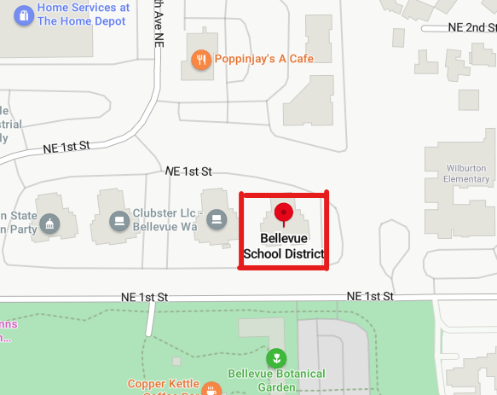
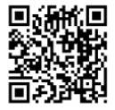
Parent Coffee Chats
Please join us for coffee and conversation!
Meet Bellevue Special Needs PTA board members and connect with other parents. This will be informal with no specific agenda. We would like to get to know you and what’s on your mind.
FREE COFFEE will be provided to all from the Everbean Coffee Shop. Everbean is staffed by young adults in the Evergreen Transition Program, our community-based job training program for individuals with disabilities ages 18-21. The program provides experiential learning opportunities for young adults to foster independence in the areas of employment, post-secondary education/training, and life skills.
When: Wednesday January 17th, 10:00 to 11:30
Wednesday Feb 28th, 10:00 to 11:30
Wednesday March 27th , 10:00 to 11:30
Where: Bellevue School District, 12111 NE 1st Street
Join the PTA

