Slide 1
SIGNIFICANT CUTS ON THE TABLE
DSHS has proposed cutting 20,000 people from long-term support
30% of DDA clients receiving community support would lose ALL services
Transition students would lose employment and other supports they need to live and participate in their communities

Slide 2
Washington has a BIG budget gap
This means the state does not have the money to pay for the support people need.
Updated 11/4/2020

Slide 3
No Money = Cuts to Supports
The state relies on money from taxes to pay for schools, healthcare, housing and food aid, disability supports, and more

Slide 4
#IAmNotOptional
Not clear what action, if any, will be taken on the CURRENT budget. It has a $1.4 billion gap.
Agencies submitted their asks for the NEXT budget to the governor. They were told (again) to identify 15% in savings. For DDA, that means about $601 million cut. For ALTSA, $1.1 billion

Slide 5
It’s Not a Service. It’s My Life
The proposed cut that most alarms us is changing the eligibility requirements for long-term services.
That means people could lose the support they need to live in the community

Slide 6
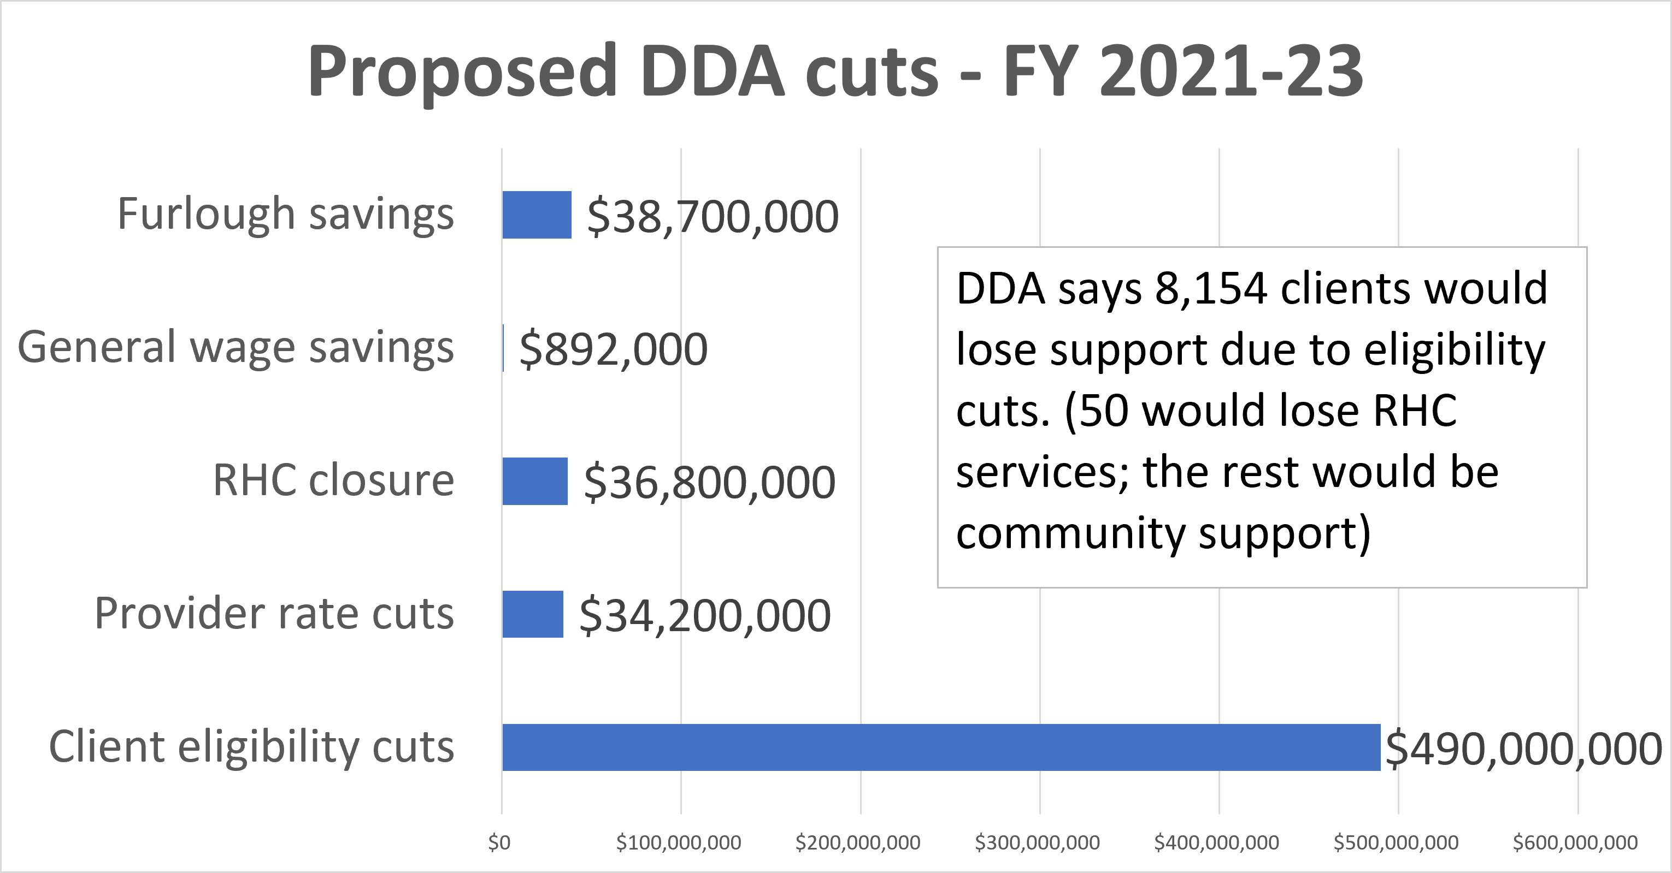
DDA budget letter: https://arcofkingcountyvoice.blogspot.com/2020/09/dda-budget-request-for-fy-2021-23.html

Slide 7
ALTSA budget letter: https://arcofkingcountyvoice.blogspot.com/2020/09/altsa-budget-request-for-fy-2021-23.html
ALTSA says 12,000 clients would lose service

Slide 8
For People with Disabilities, This Could Mean:
Losing your job, and connections to friends
Losing mobility, and being hospitalized
Losing your home, because you can’t live independently
More people may experience health crisis
More families may face economic crises
Community supports are a lifeline

Slide 10
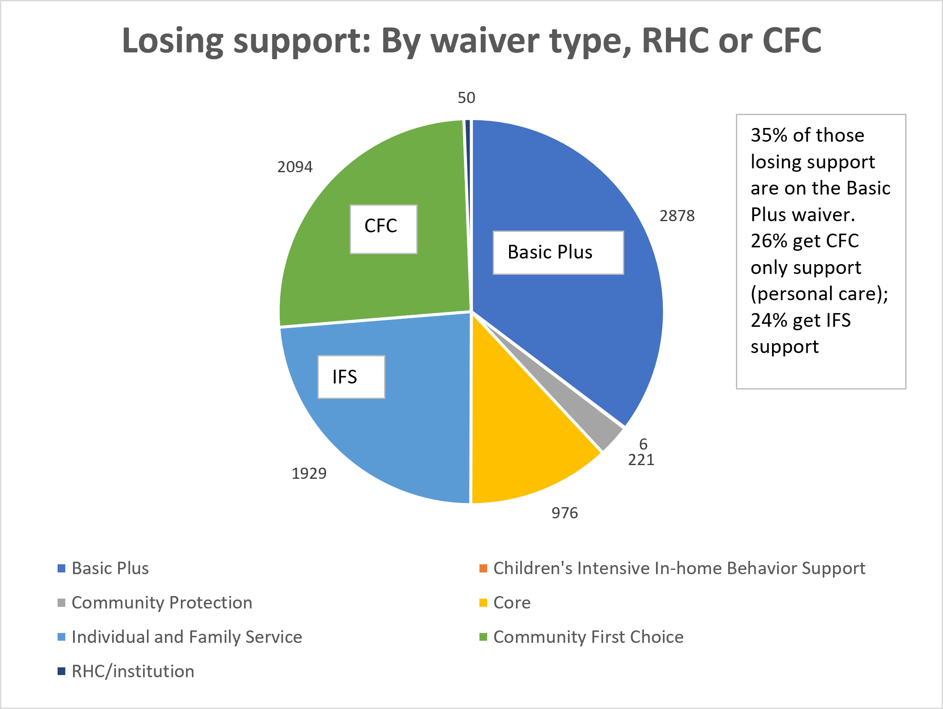
Basic Plus is the waiver that gives young adults access to job support.
Under the proposed scenario, 35% of clients losing support would be clients on the Basic Plus waiver … AND very few going forward would ever qualify.

Slide 11
“Waivers” offer a menu of supports. Following are ones on the IFS waiver. Basic Plus is similar but also offers employment support. Core offers employment and residential support
Respite Care (Break to the Caregiver)
Behavior support and consultation
Assistive Technology
Community Engagement
Speech, Hearing and Language therapy
Occupational therapy
Physical therapy
Environmental accessibility modifications
Vehicle modifications
Specialized medical equipment and supplies
Specialized clothing
Therapeutic equipment and supplies
Transportation
Specialized psychiatric services
Staff/Family consultation & training
Nurse delegation
Skilled nursing
Psychosexual evaluation
Peer mentoring
Person centered planning facilitation
Supported parenting service
Wellness Education Letter
Behavior Health Stabilization Services
Behavior support and consultation
Specialized psychiatric services

Slide 12
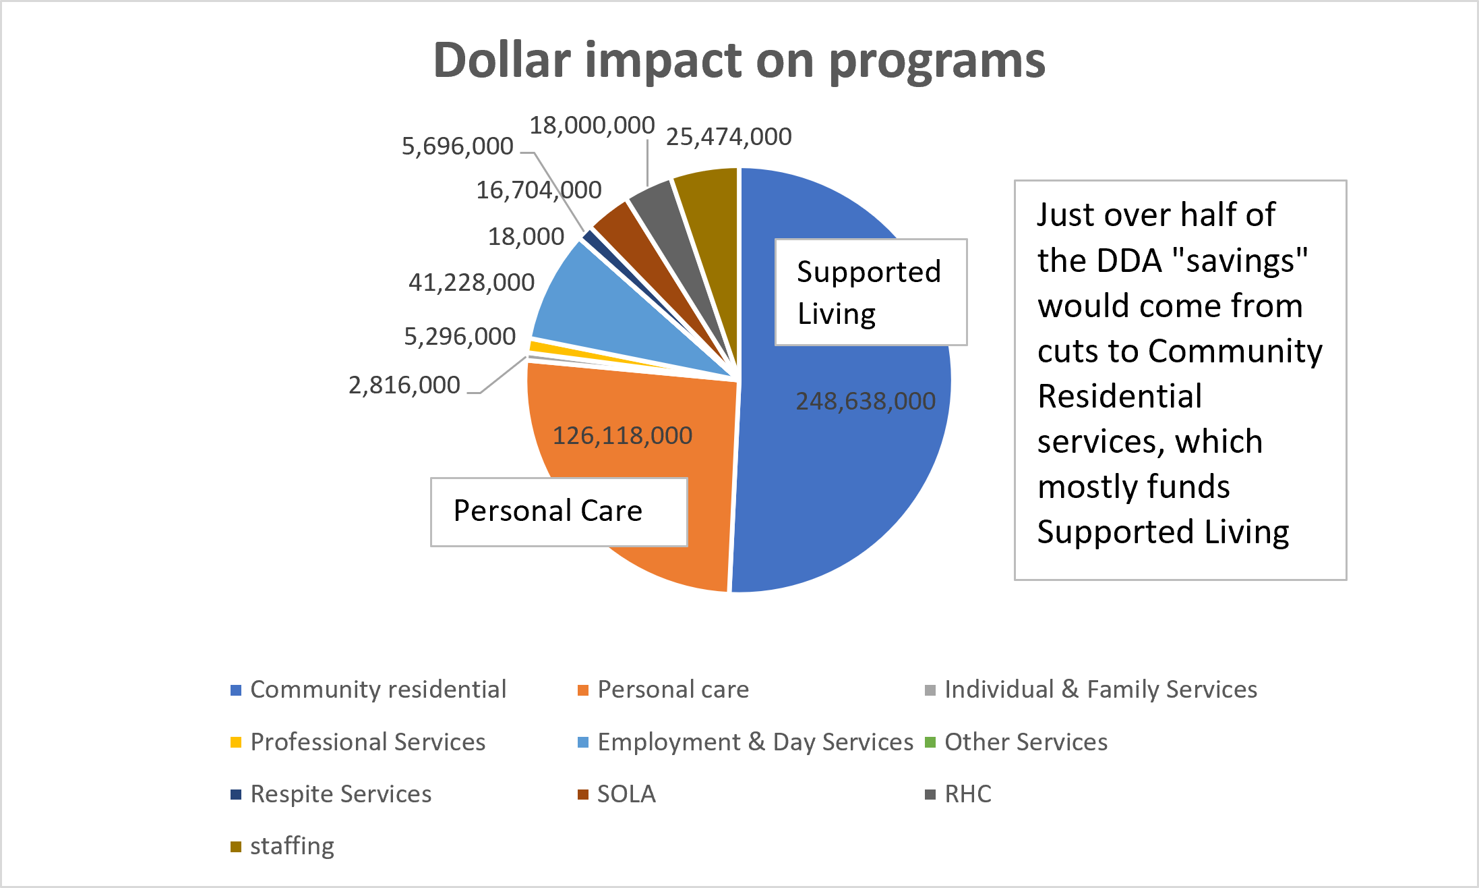

Slide 13
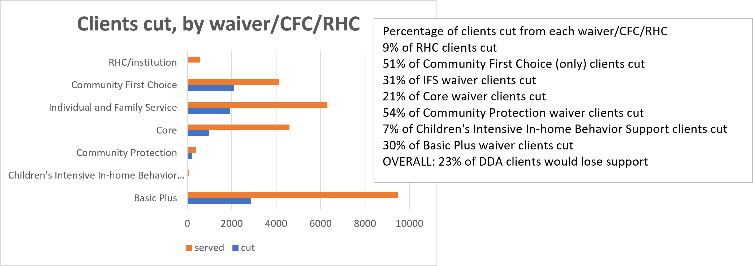
23% of all DDA clients would lose support. That increases to 30% of clients getting community supports

Slide 14
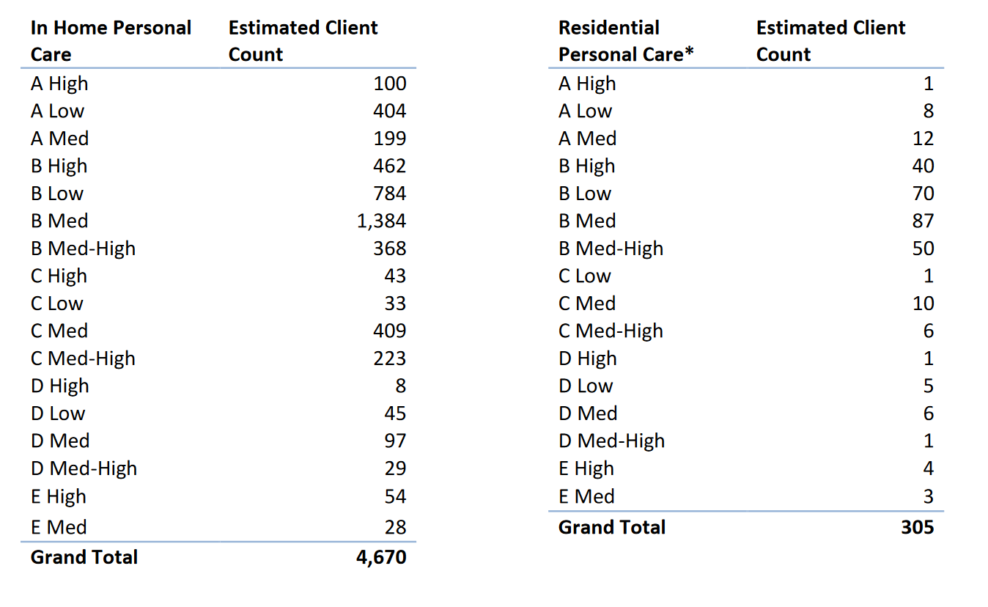
Arbitrary. The models show people at the highest classification levels losing ALL support. When asked which factors determined winners and losers, DDA could not answer. “It’s not that simple.”

Slide 15
ALTSA CUTS
Added additional activities for daily living requirement (for most, from 3 to 4)
Changes would most impact people who require cognitive support (behavioral health, traumatic brain injury, early diagnosis of dementia, etc)

Slide 17
Is There Help?
There is some federal stimulus money, but there are lots of rules about what it can be used for
There is state money set aside for emergencies, but there is not enough to fix the problem

Slide 18
Is There Help?
Advocates asked Congress to fund more home and community-based services. These are another name for DDA waiver services.
So far, Congress has not increased those funds.
Even if they did, Washington would lose out if they cut eligibility. Funds come as a match

Slide 19
Value of safety nets
Supports help people build connections and resiliency
Safety nets catch people, so they don’t fall into crisis
ALL SERVICES ARE CRITICAL – even if support means just a few hours a week. When you cut support, you push people into another “system,” such as homelessness response.

Slide 20
We Need Your Help
We want to make sure people who cut supports understand they will hurt people with intellectual and developmental disabilities, their families, and the workers who support them
You can help: Share your story. Be loud.

Slide 21
Some Talking points
41st … and falling? Washington’s system of supports for people with developmental disabilities is fragile and inadequate, serving less than 30 percent of the people it should*. The DDA budget is built off current expenses, not on increasing or unmet need, or even on numbers who qualify. Our state is 41st in spending, has high case manager ratios (1 to 75), and already rations care, leaving thousands waiting for essential access to health, housing, education, and jobs.
15% cuts are really 30% once you factor in loss of matching federal dollars. And the impact can feel even greater. Demand for emergency care and housing, food, and behavioral health supports all jump when long-term supports are cut.
Deepest poverty. People with a cognitive /behavioral disability face the highest rates of poverty in the state. These folks make up the core of people with developmental disabilities. For those who rely on them, supports are so much more than safety and security:
Personal care literally means being able to get out of bed
Residential support means access to a home
Employment support means access to jobs

Slide 22
Some Talking points
The domino effect. When people secure a waiver through DDA they also secure Medicaid Apple Health, food benefits, and in King County, possibly mental health support via Sound. Home and job are often directly tied to supports.
One event away from crisis. ALL clients need the support. Whether they need just 1 support once a week, or several 24/7, that support is what is keeping them – and their families – out of crisis. Cut support and hospitals/ERs see increases; institutional care increases; homelessness increases; and incarceration increases.
Ending chronic homelessness saves taxpayers money. In King County, we know about two-thirds of the homeless population has a disability, and national research shows 30 to 40 percent of people experiencing homelessness have an intellectual disability. Research also shows that providing supportive housing cuts costs to society by almost half. So why would the state cut the supports that keep people with DD (and often their families) out of chronic homelessness?

Slide 23
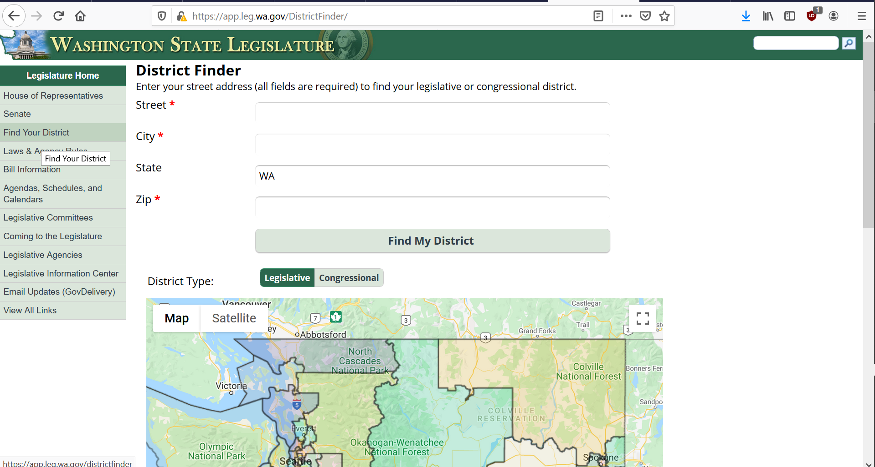
What can you do?
We want to make sure people who cut supports understand they will hurt.
Let leaders know cuts would be devastating
Also …
Contact the governor
The Arc of WA action alerts: https://arcwa.org/action-center/
https://app.leg.wa.gov/DistrictFinder/

Slide 24
Stay in touch
Sign up for advocacy newsletters, https://signup.e2ma.net/signup/1894973/1898164/ Advocacy resources:
King County Parent and Family Coalition, general advocacy for DD issues
Community Change Champions, advocacy support for people with disabilities
Robin Tatsuda​
Executive Director​
rtatsuda@arcofkingcounty.org​
206.829.7011
Ramona Hattendorf​ Director of Advocacy​
rhattendorf@arcofkingcounty.org​
206.829.7048

